Slide 1
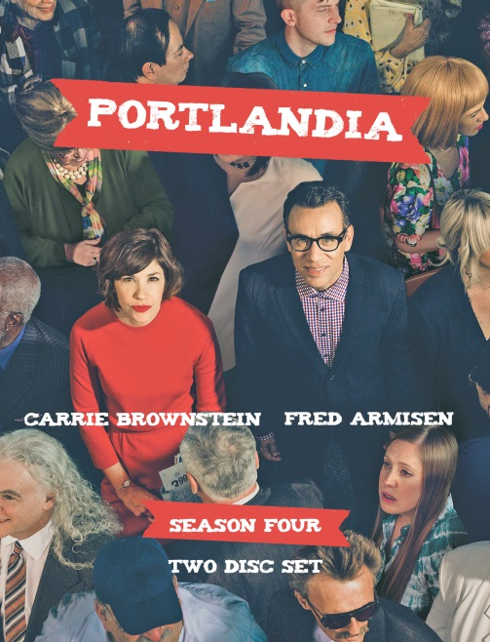
f
Season Four
Portlandia is IFC's hit sketch comedy series created, written by, and starring Fred Armisen (SNL) and Carrie Brownstein (WILD FLAG, Sleater-Kinney vocalist/guitarist). The show is driven by a series of hilarious character-based shorts all of which take place in ""Portlandia,"" the creators' dreamy and absurd rendering of Portland, Oregon where '90s culture reigns supreme and political correctness is all the rage.
Season 4 guest stars include Kristen Dunst, Olivia Wilde, Steve Buscemi, St. Vincent, Maya Rudolph, Gus Van Sant, the Portland Trail Blazers basketball team, and more.
Broadcast on IFC in the US, and Super Channel in Canada
Peabody Award-winner
Emmy nominee
Supported by a national publicity and advertising campaign
Previous seasons have shipped over 70,000 units in North America
Release Date: August 26, 2014
ARTWORK NOT FINAL
TITLE | DISC COUNT | UPC | CAT# | TRT | BOX LOT | SRP
Portlandia S4 DVD | 2 | 7-78854-20779-0 | BRO2077 | 220 min | 30 | $19.98
US and Canada contact Video Services Corp ph:416-597-8325/1-877-341-7577 email:vidserv@globalserve.net website:www.videoservicescorp.com
US contact MVD 610-650-8200

