Slide 1
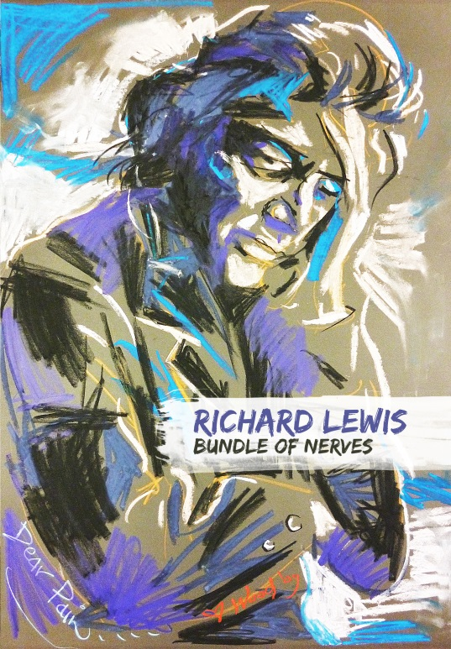
Richard Lewis: Bundle of Nerves
Two discs containing four films featuring the comic Richard Lewis. It’s the definitive Lewis set, containing his HBO special Magical Misery Tour, NBC special Diary of a Young Comic, the theatrical feature Drunks and a brand new documentary House of a Lifetime, plus all-new bonus features and introductions!
Richard Lewis is touring the US in the summer and fall
Supported by a national publicity and social media campaign, with Richard appearing on late night talk shows
Disc 1
HBO special Magical Misery Tour and NBC special Diary of a Young Comic
Disc 1 Bonus Features
Diary of a Young Comic commentary with Richard Lewis and co-writer Bennett Tramer
Newly shot introductions to each feature with Richard Lewis
Disc 2
HBO Theatrical feature Drunks and brand new documentary House of a Lifetime
Disc 2 Bonus Features
Commentary with Richard Lewis and Drunks Director Peter Cohn
House of a Lifetime - a documentary created for this disc set, featuring Richard's house and its rock'n'roll history
Newly shot introductions to each feature with Richard Lewis
Release Date: September 2, 2014
TITLE | DISC COUNT | UPC | CAT# | TRT | BOX LOT | SRP
Richard Lewis: Bundle of Nerves DVD | 2 | 7-78854-20569-7 | LEW2056 | 305 min | 30 | $29.98
US and Canada contact Video Services Corp ph:416-597-8325/1-877-341-7577 email:vidserv@globalserve.net website:www.videoservicescorp.com
US contact MVD 610-650-8200

