Slide 1
Coverage to April 29, 2019

Slide 2
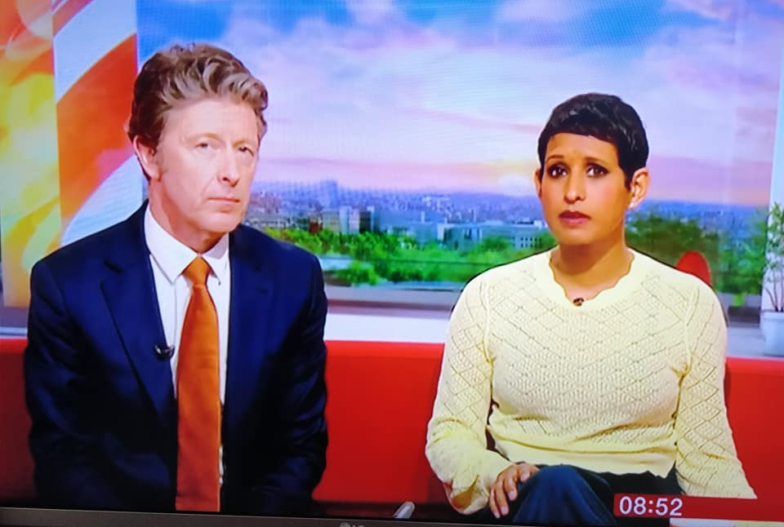
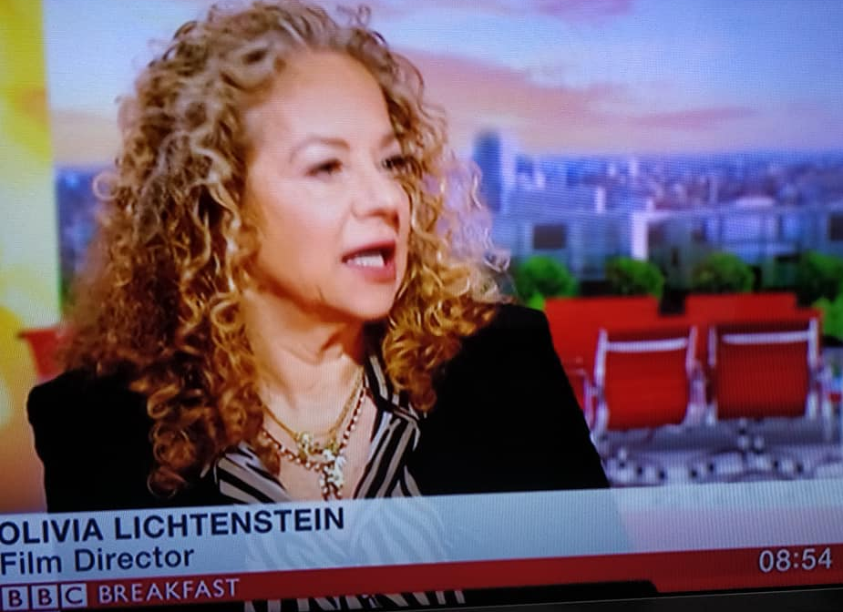
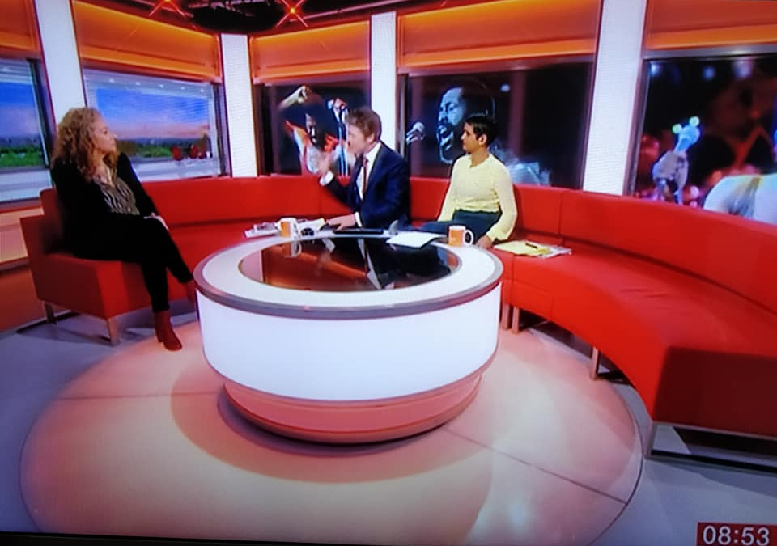
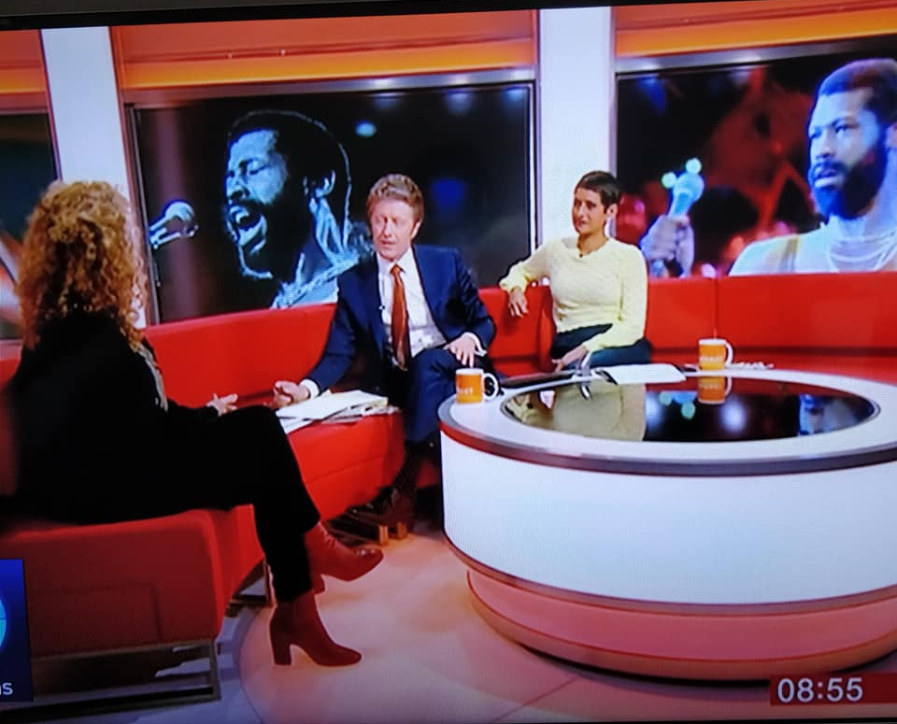
BBC Breakfast News 8.52am (4 minute interview) viewership: 1.6million 16th March 2019

Slide 3
Trevor Nelson Rhythm Nation BBC Radio 2 Circ: 2,162,450 AVE: £43,249 22nd February 2019 https://www.bbc.co.uk/programmes/m0002s25

Slide 4
https://www.bbc.co.uk/sounds/play/m0002n6s
Feb 22, 2019
The review is at 1:36:00 into the programme - with Edith Bowman and Clarisse Loughrey

Slide 5
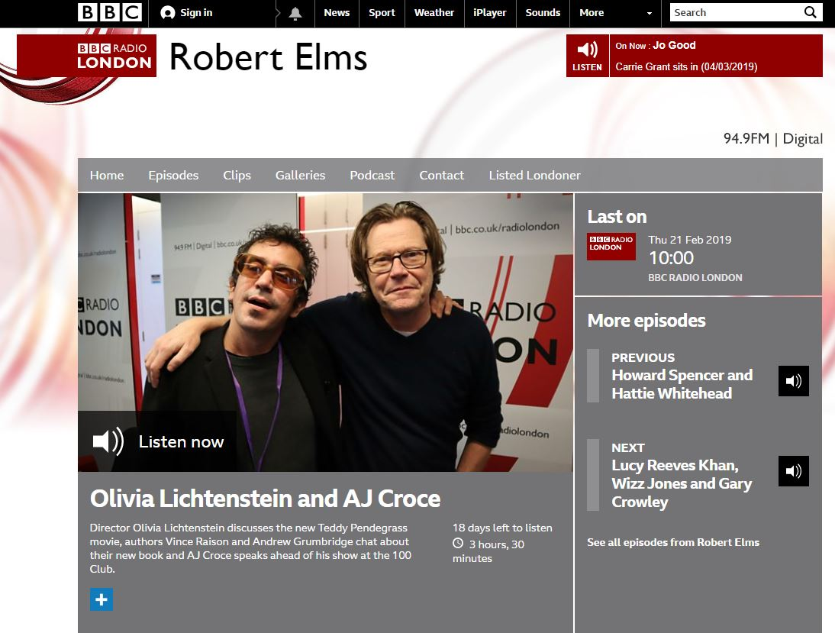
Robert Elms Interview
Feb 21, 2019
BBC Radio London
124,700 listeners

Slide 6
Graham Norton Twitter 1.36 million followers 20th February 2019 88 likes, 5 comments, 3 retweets

Slide 7
The Guardian (Guide) Circ: 19,152 AVE: £5,736 2nd March 2019

Slide 8
The Guardian (Guide) Circ: 19,152 AVE: £5,736 2nd March 2019

Slide 9
The Guardian (Guide) Circ: 19,152 AVE: £5,736 2nd March 2019

Slide 10
The Guardian (T2) Circ: 141,461 AVE: £11,900 22nd February 2019

Slide 11
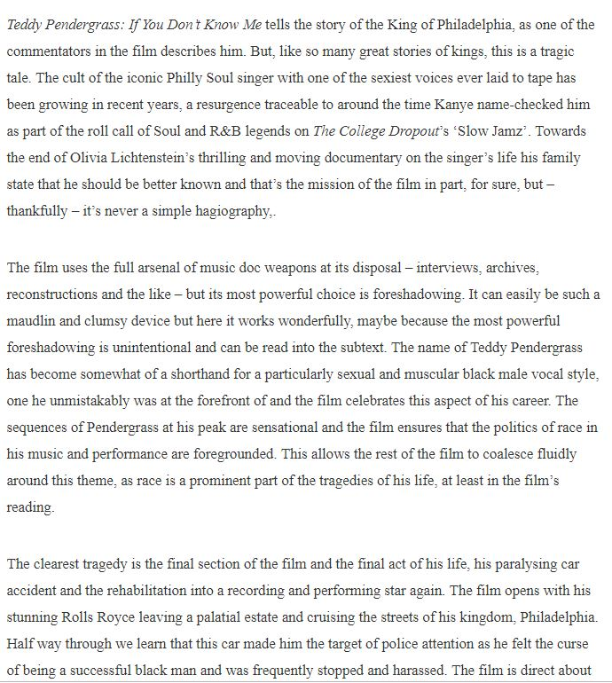
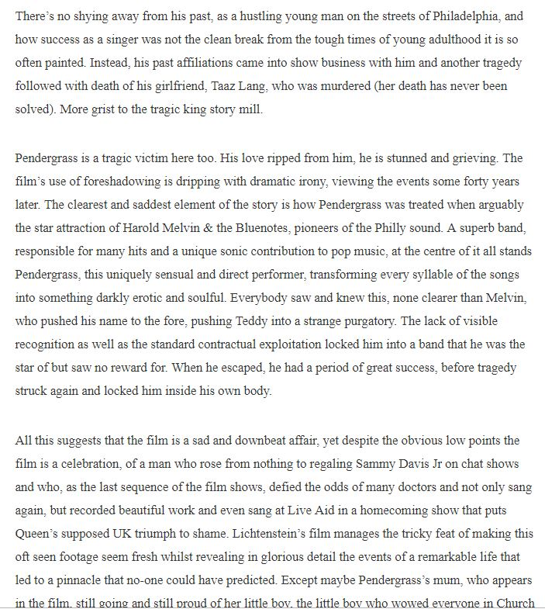
The Quietus
Feb 15, 2015
https://thequietus.com/articles/26047-teddy-pendergrass-if-you-dont-know-me-olivia-lichtenstein-review

Slide 12
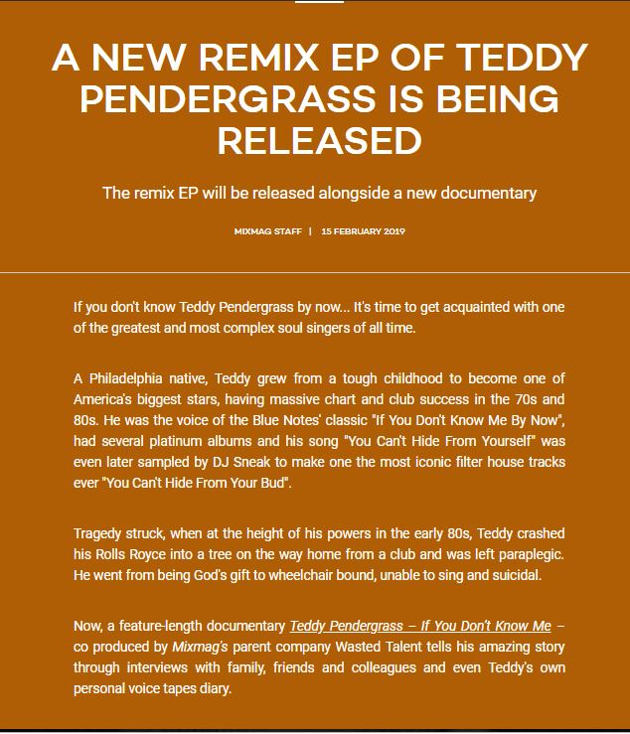
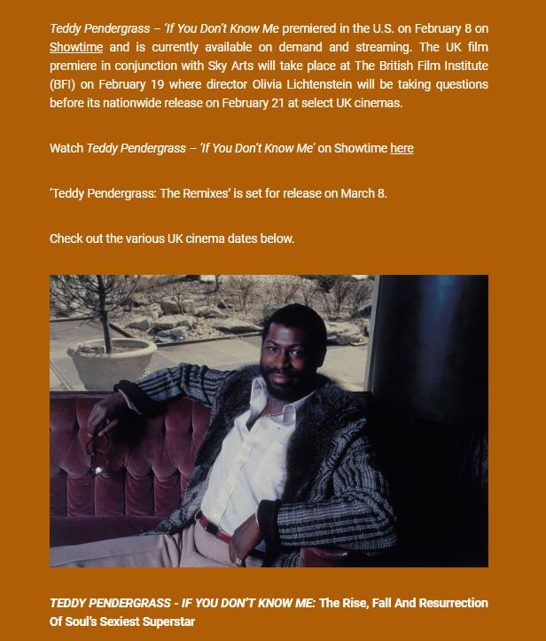
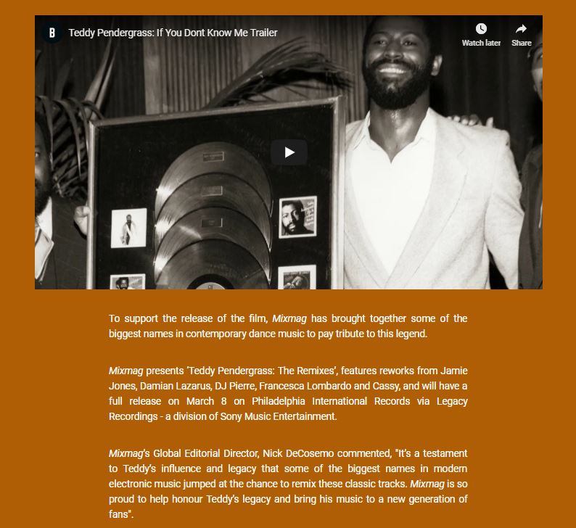
MixMag
Feb 15, 2019
https://mixmag.net/feature/new-remix-ep-teddy-pendergrass-branded-content

Slide 13
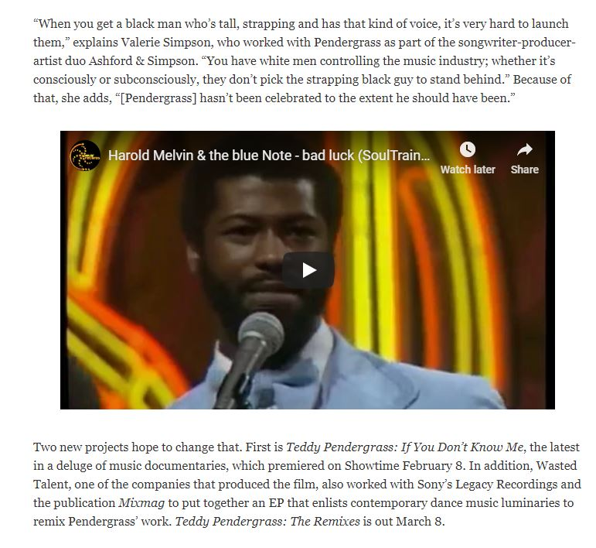
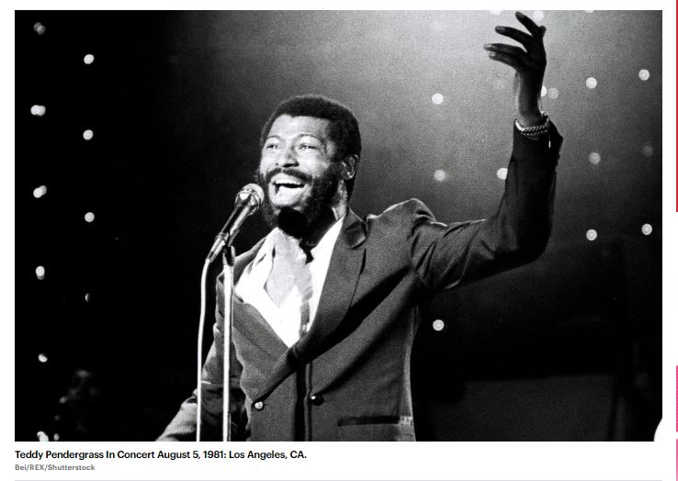
Rolling Stone
Feb 27, 2019
Circ: 116,515
https://www.rollingstone.com/music/music-features/teddy-pendergrass-showtime-documentary-remix-ep-799952/

Slide 14
Metro Circ: 866,189 AVE: £2,898 20th February 2019

Slide 15
London Live (Spotlight) repeated interview Viewers: 222,300 AVE: £2,230 5pm, 2nd March 2018 Originally aired on Monday February 18th
https://mygorkana.com/x/mediaclips/broadcast/448473134

Slide 16
Northern Echo Circ: 35,382 AVE: £3,775 1st March 2019

Slide 17
Northern Echo Circ: 35,382 AVE: £3,775 1st March 2019

Slide 18
The Voice Circ: 30,000 AVE: £4,069 14th February 2019 Also online https://www.voice-online.co.uk/article/new-documentary-will-shed-light-life-teddy-pendergrass

Slide 19
The Voice Circ: 30,000 AVE: £4,069 14th February 2019

Slide 20
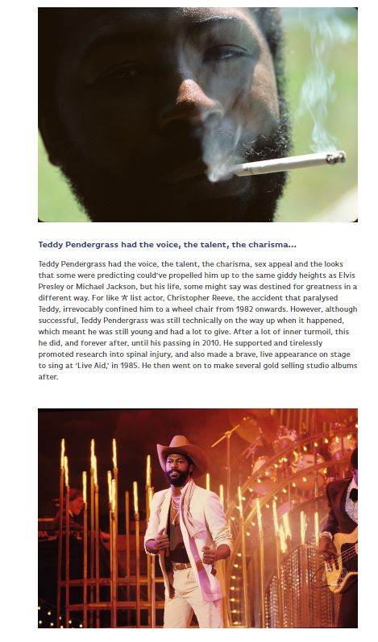
https://www.britflicks.com/blog/post/7783/TEDDY-PENDERGRASSIF-YOU-DON-T-KNOW-MEBritFlicks-Reviews-Olivia-Lichtenstein-Documentary/

Slide 21
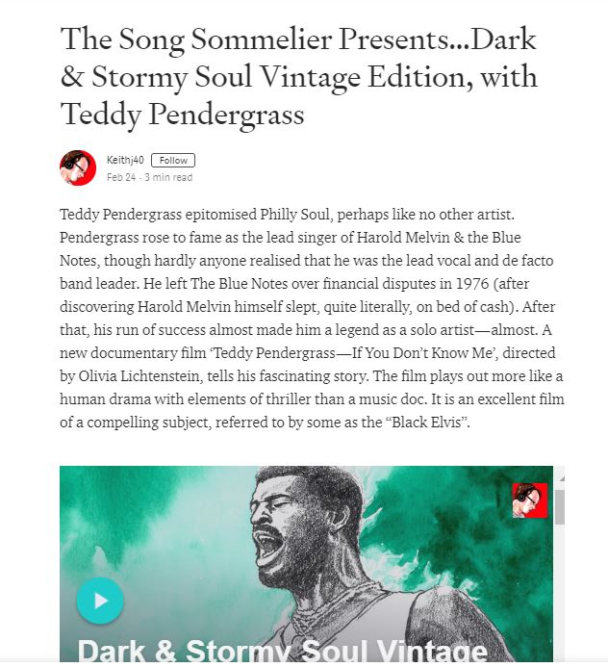
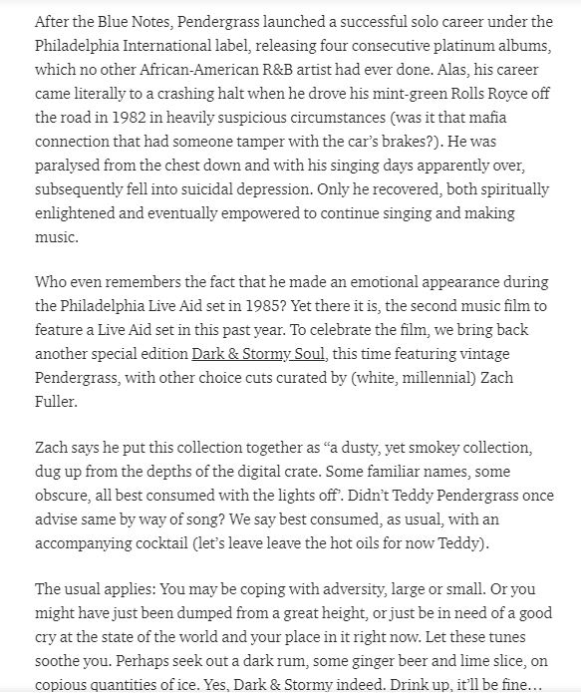
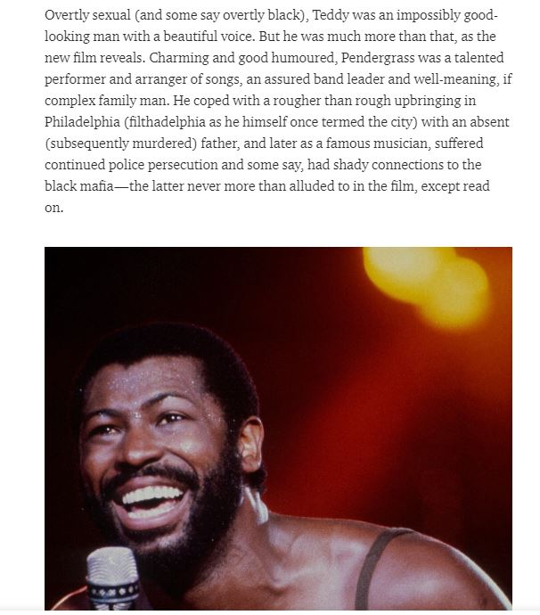
Medium
https://medium.com/@keith.jopling/the-song-sommelier-presents-dark-stormy-soul-vintage-edition-with-teddy-pendergrass-df94d75d65e6

Slide 22
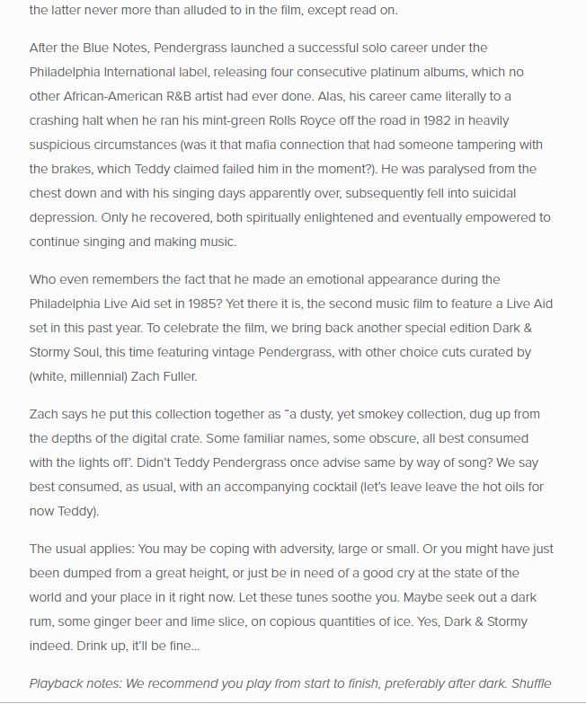
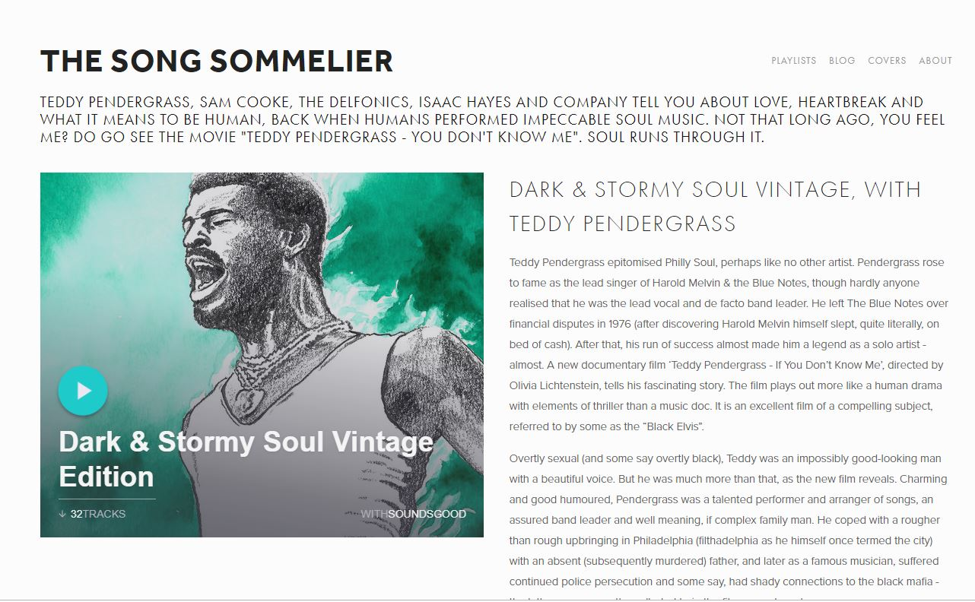
Song Sommelier
https://www.songsommelier.com/playlist-blog/2019/2/23/dark-amp-stormy-soul-vintage-edition

Slide 23
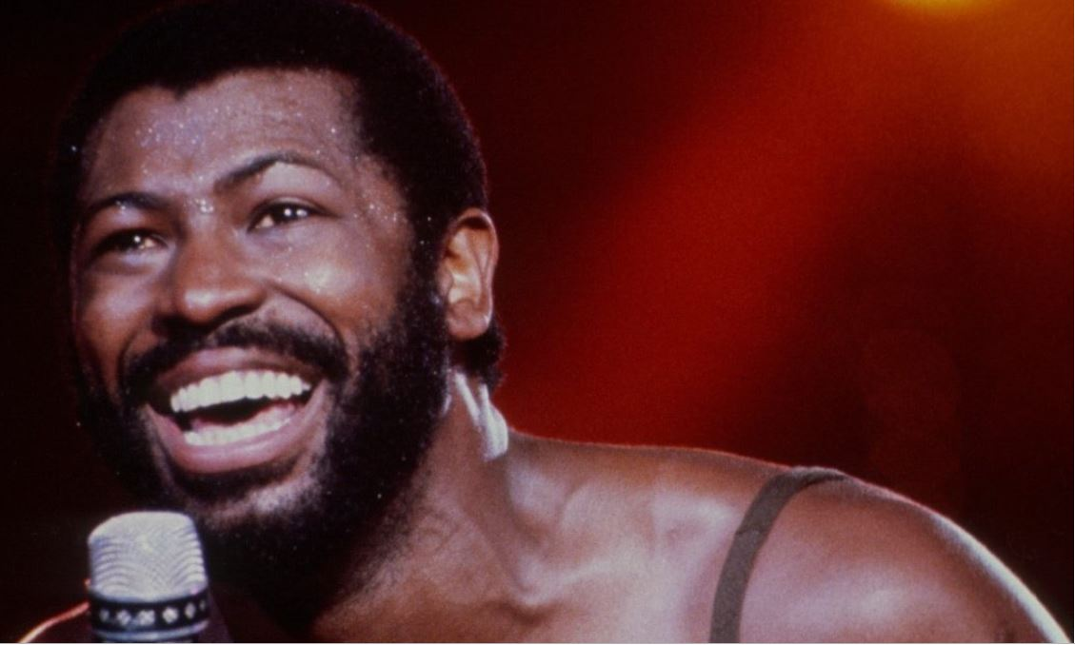
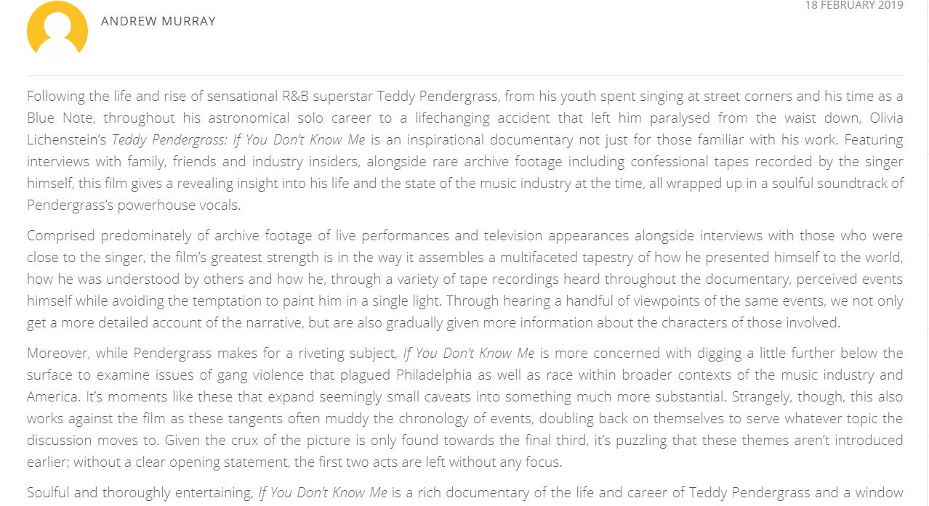
The Upcoming
Feb 18, 2019
https://www.theupcoming.co.uk/2019/02/18/teddy-pendergrass-if-you-dont-know-me-movie-review/

Slide 24
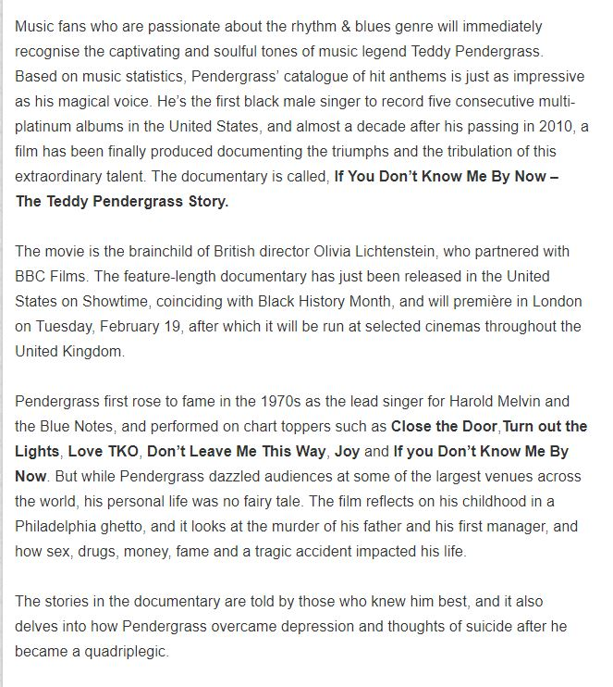
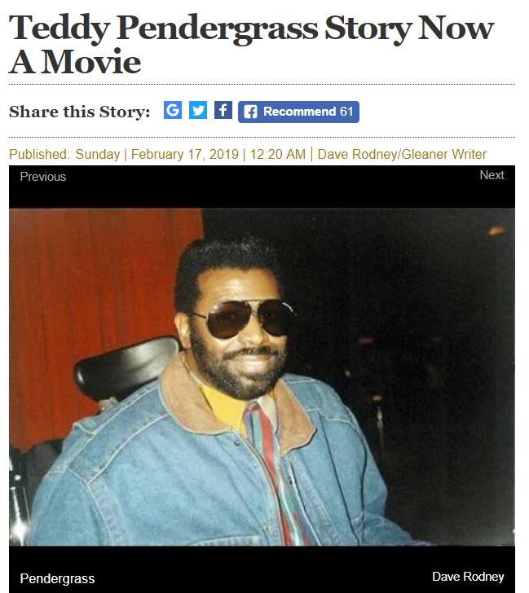
The Gleaner
Feb 17, 2019
http://www2.jamaica-gleaner.com/article/entertainment/20190217/teddy-pendergrass-story-now-movie

Slide 25
Jewish Chronicle Circ: 20,141 AVE: £3,250 22nd February 2019

Slide 26
Echoes Magazine Circ: 20,000 AVE: £850 1st February 2019

Slide 27
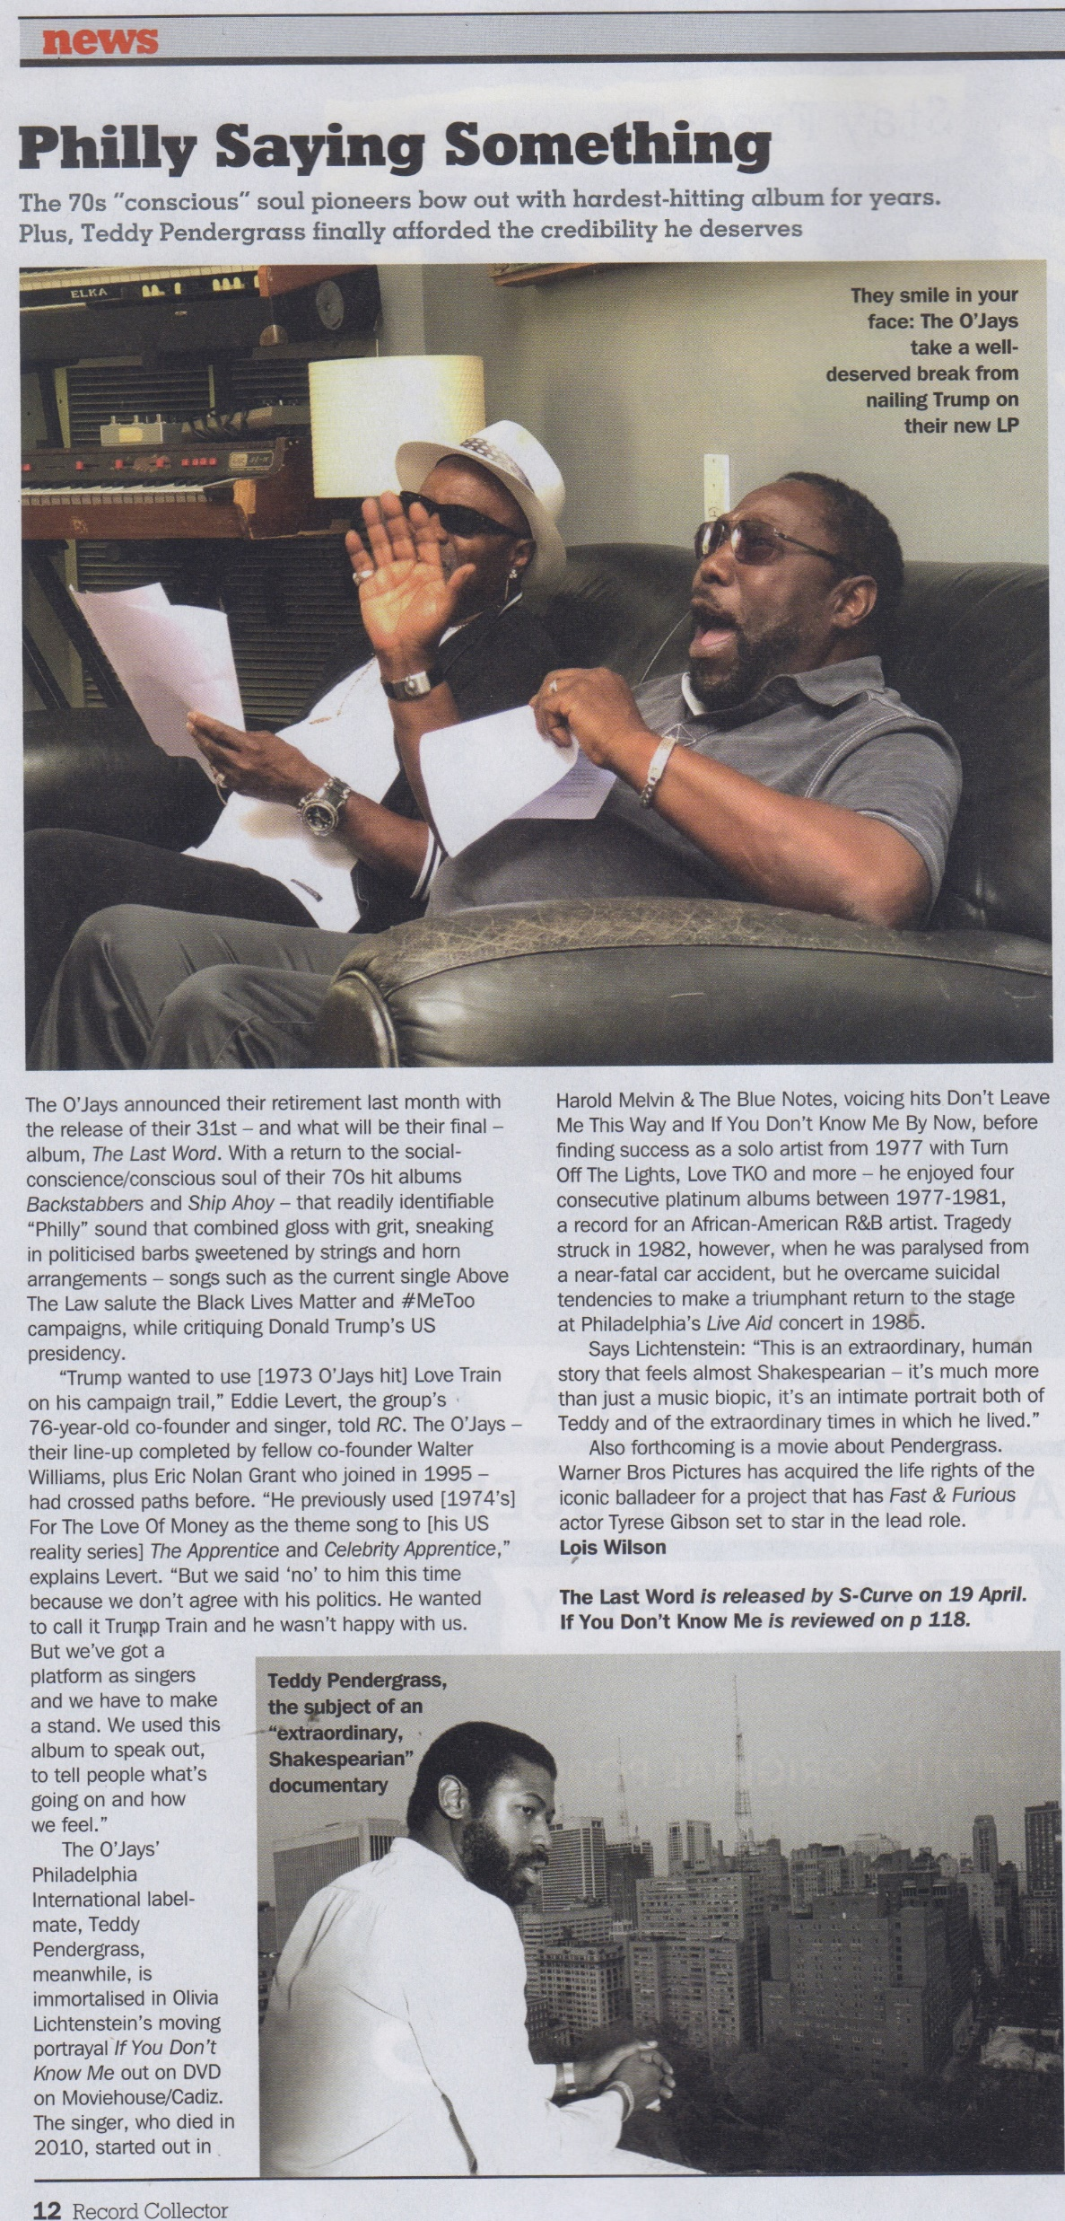
Record Collector
April 2019 issue News piece
Circulation circa 35,000

Slide 28
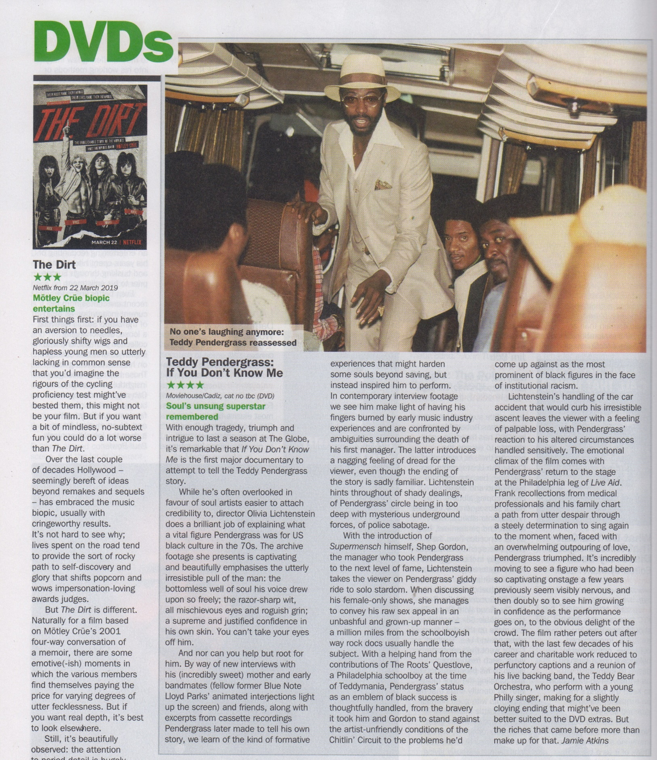
Record Collector
April 2019 issue
DVD Review
Circulation circa 35,000

Slide 29
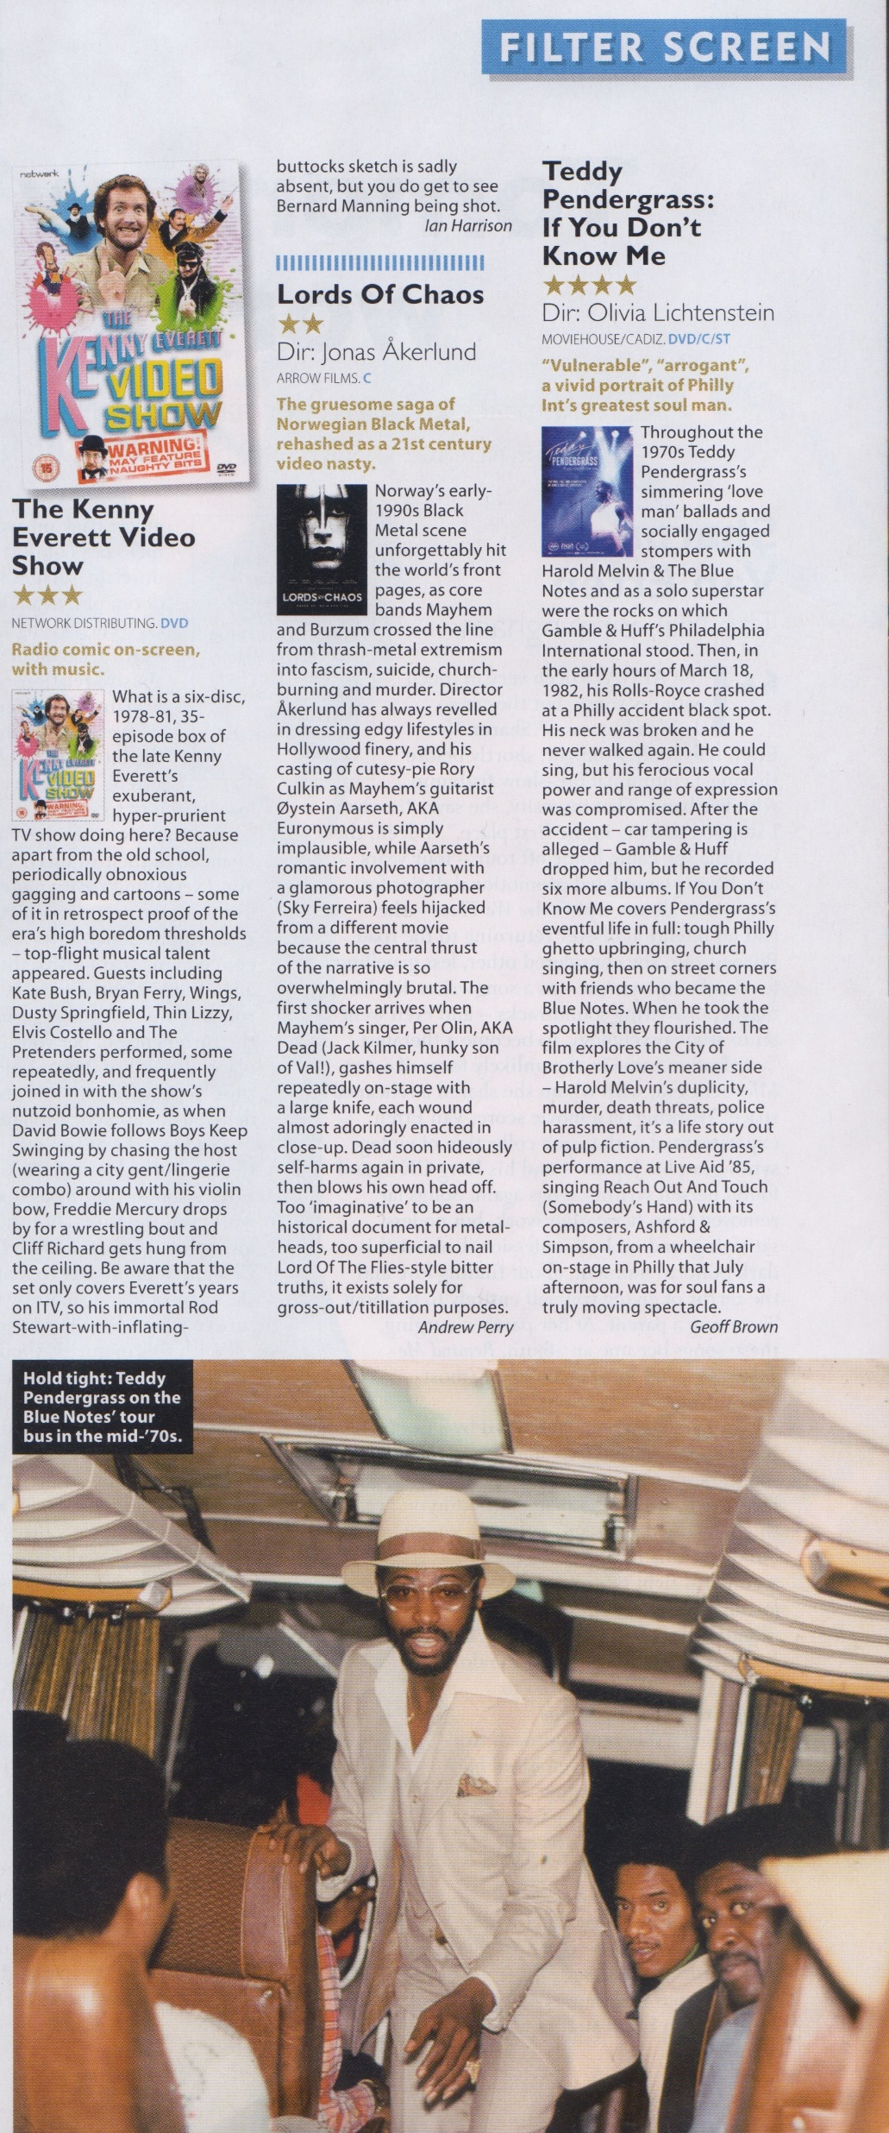
Mojo DVD Review
June issue, 2019
Circulation circa 58,000

Slide 30
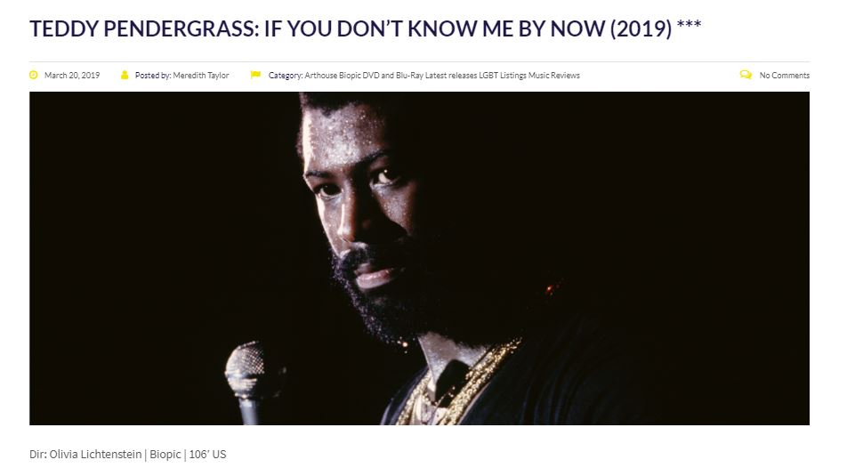
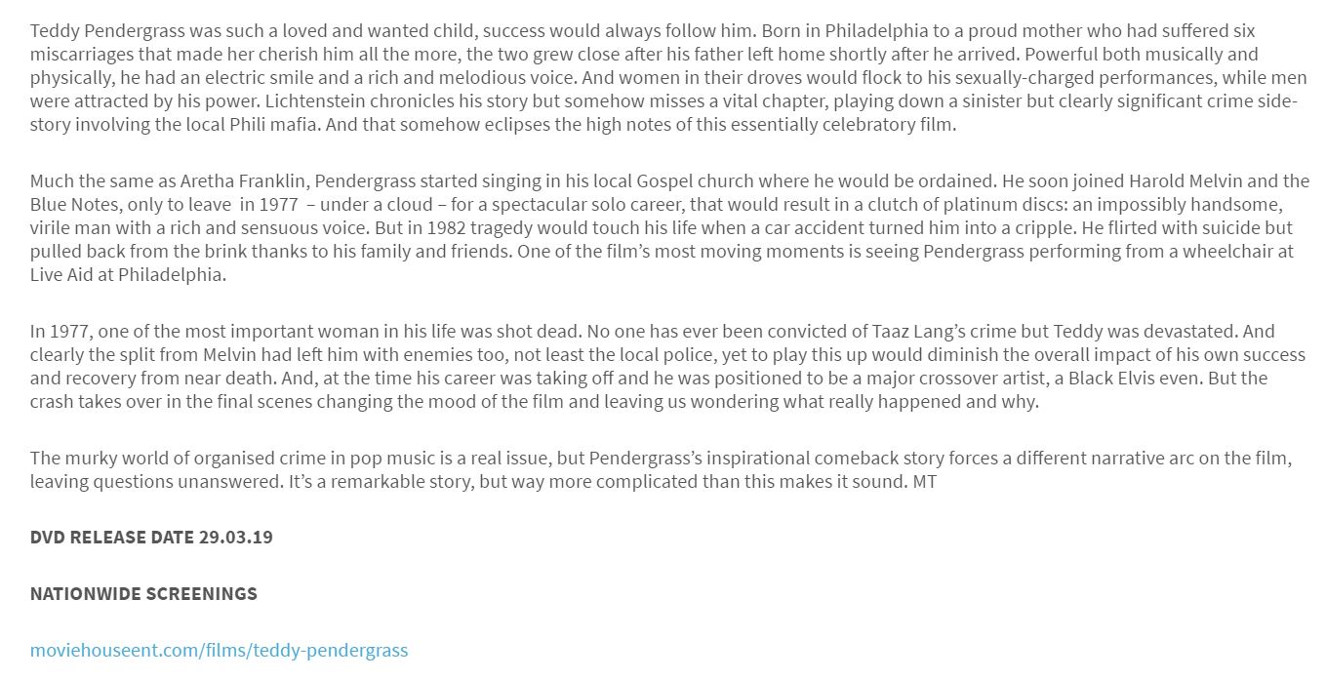
http://www.filmuforia.co.uk/teddy-pendergrass-if-you-dont-know-me-by-now-2019/
Filmuforia
March 20, 2019

Slide 31
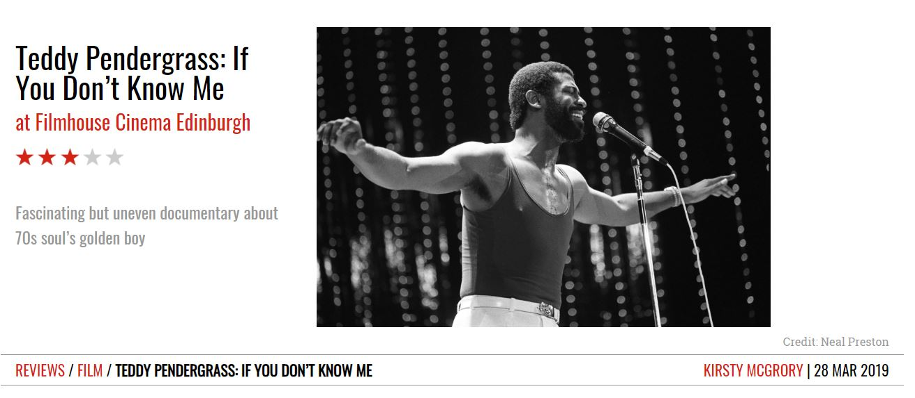
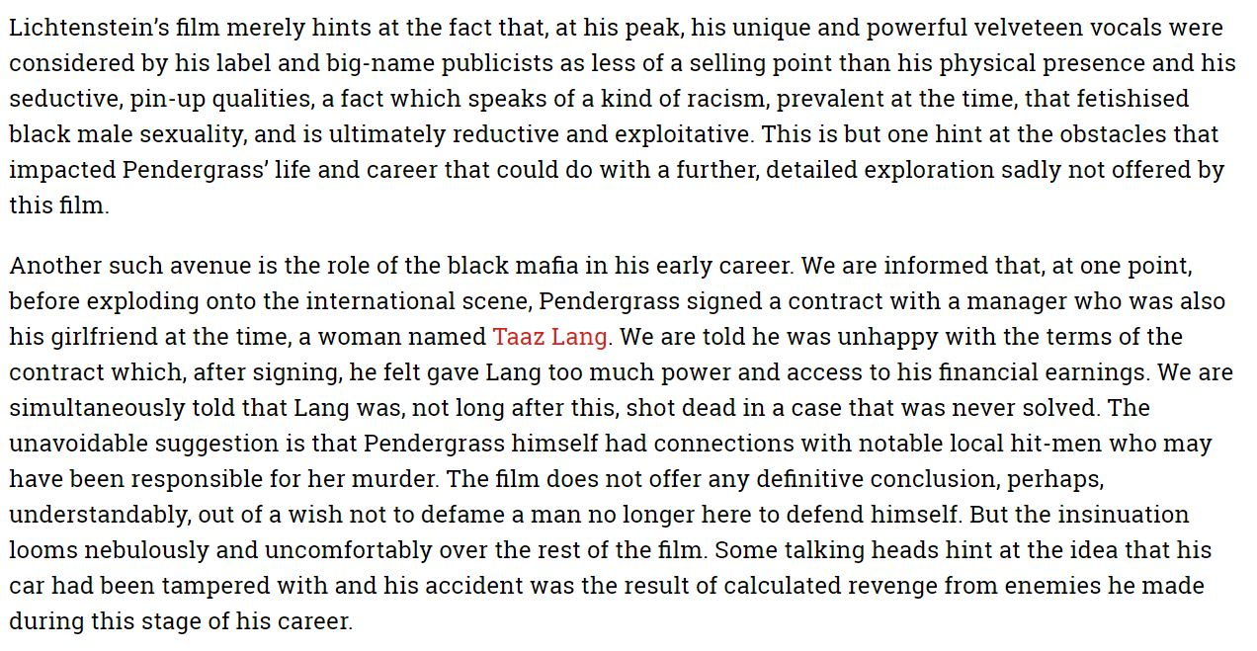
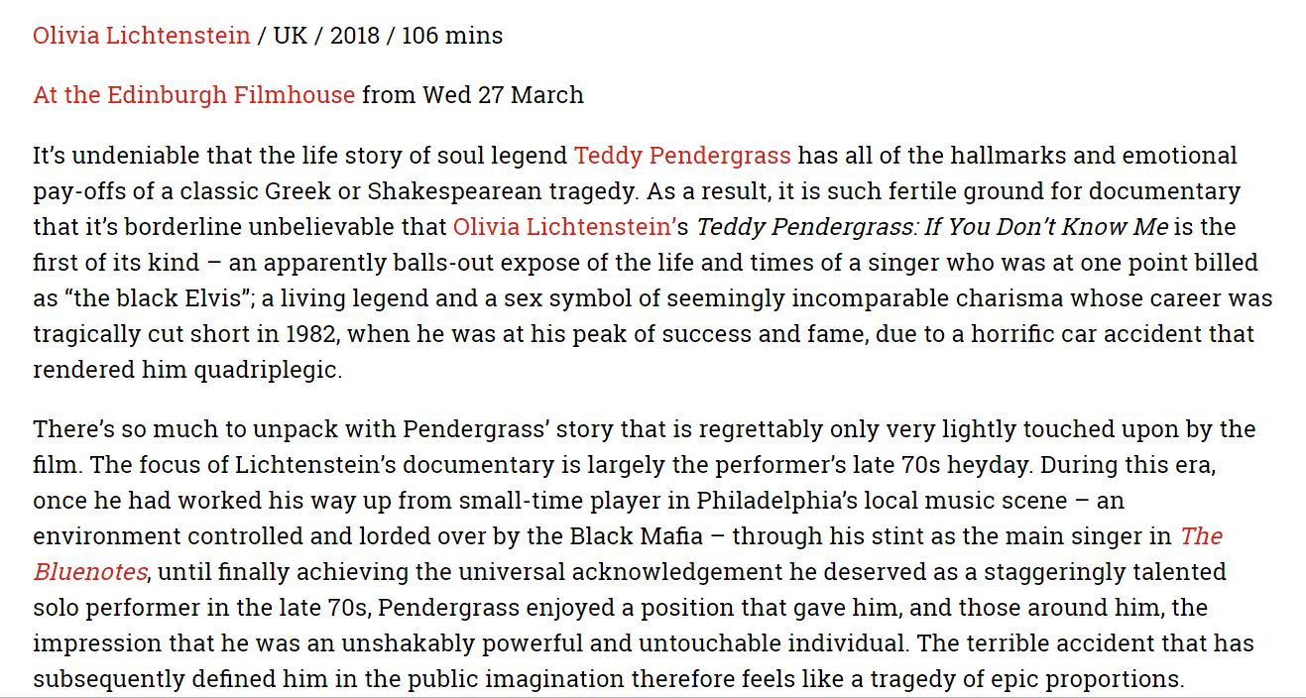
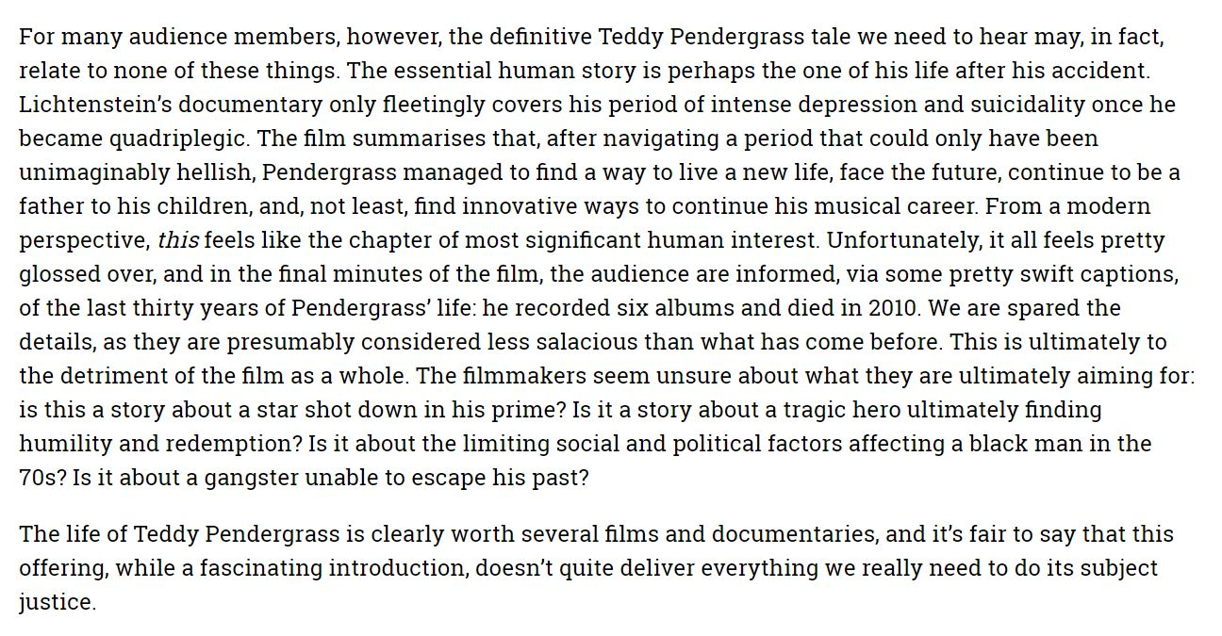
https://theweereview.com/review/teddy-pendergrass-if-you-dont-know-me/

Slide 32
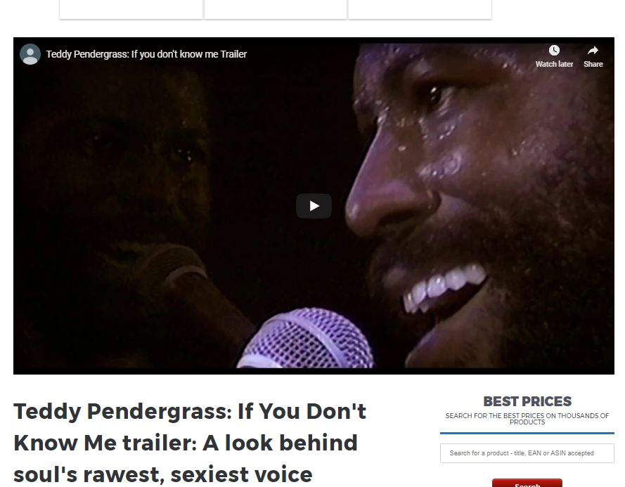
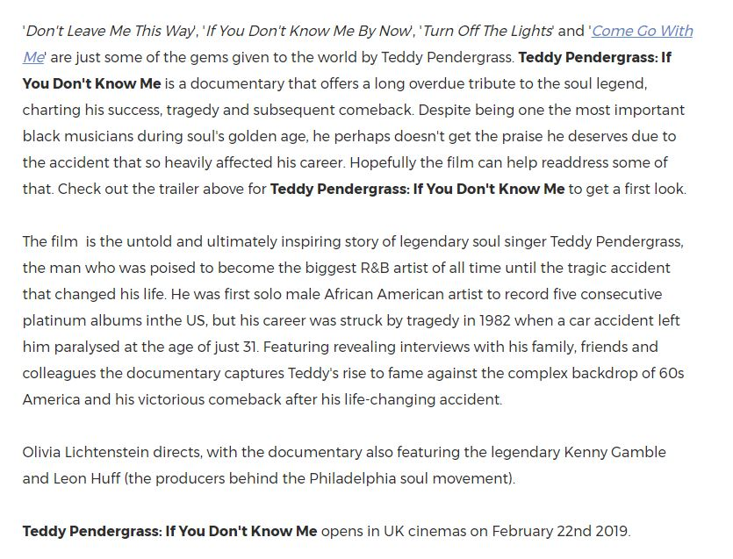
https://www.thedigitalfix.com/film/content/101281/teddy-pendergrass-if-you-dont-know-me-trailer/
The Digital Fix
Teddy P Trailer

Slide 33
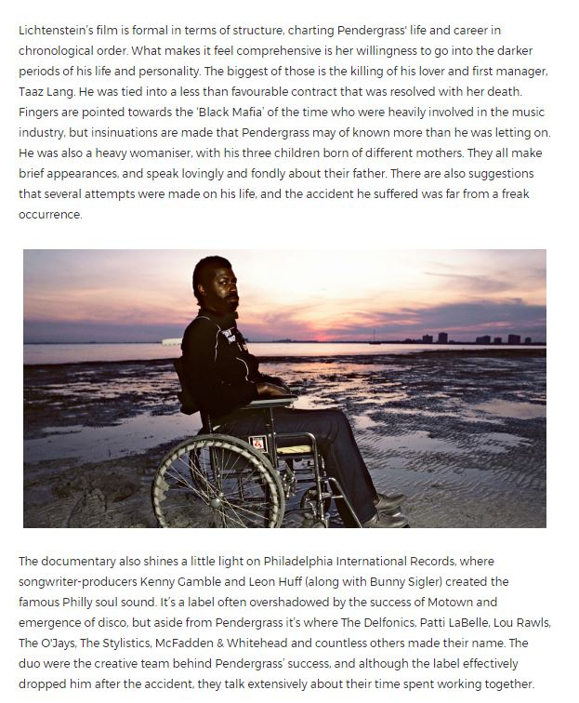
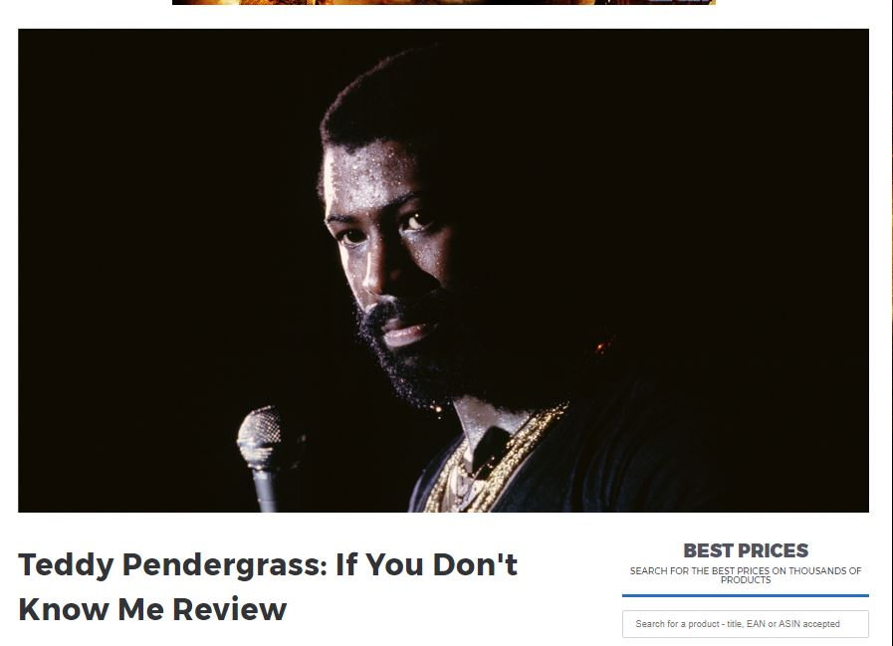
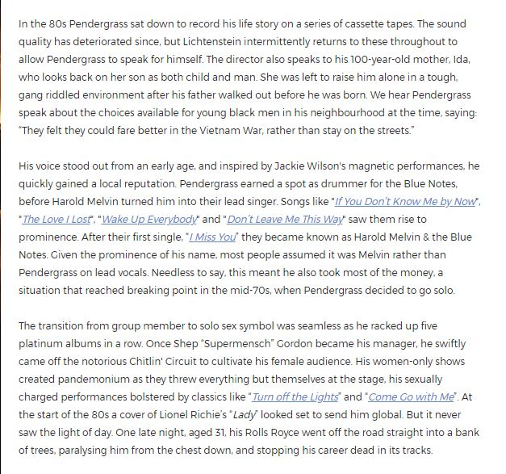
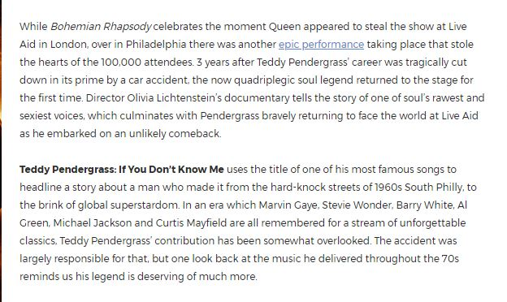
The Digital Fix Teddy P Review
https://www.thedigitalfix.com/film/content/102742/teddy-pendergrass-if-you-dont-know-me/

Slide 34
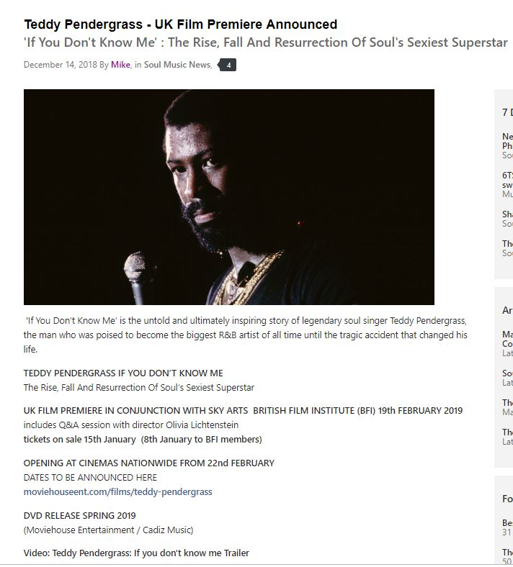
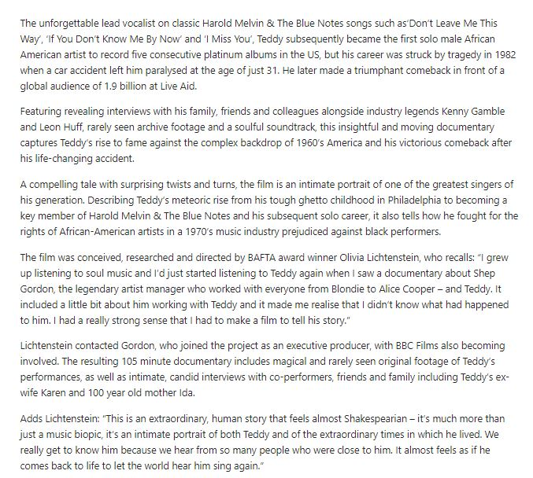
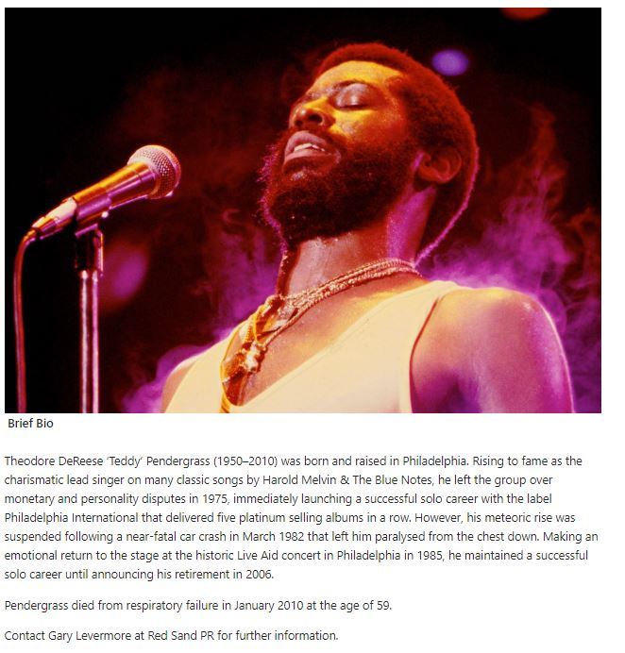
Soul Source including the film trailer
https://www.soul-source.co.uk/articles/news-soul/teddy-pendergrass-uk-film-premiere-announced-r3949/

Slide 35
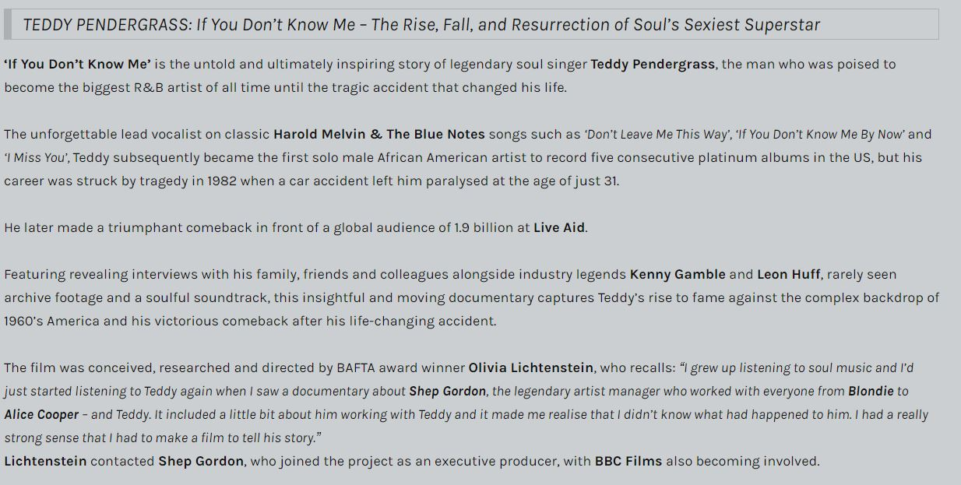
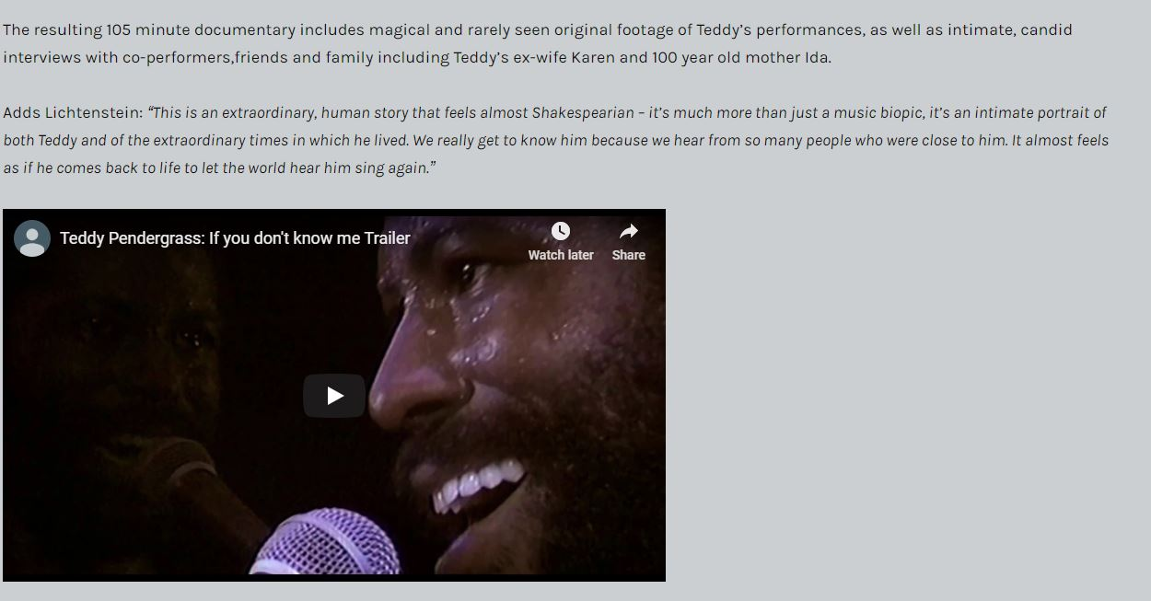
MusicVein Teddy P trailer, poster and imagery and theatrical release news
https://musicvein.co.uk/2018/12/14/the-teddy-pendergrass-movie-coming-to-cinemas-february
2019/https://musicvein.co.uk/2019/02/17/teddy-pendergrass-movie-in-cinemas-nationwide/

Slide 36
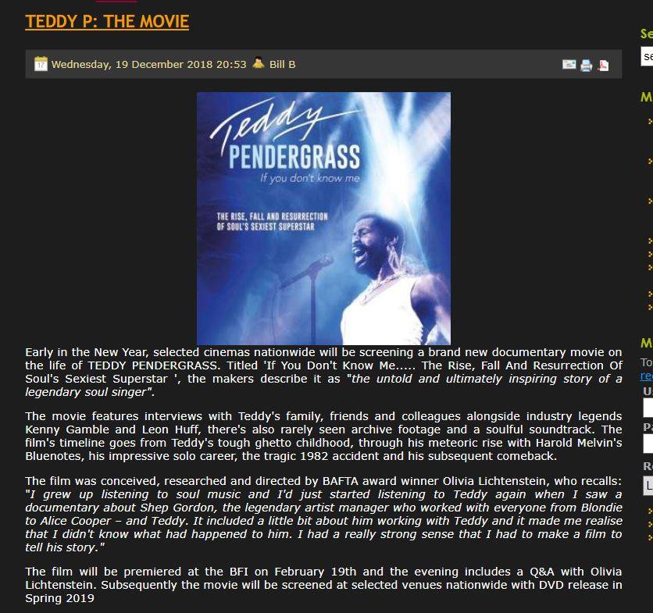
Soul, Jazz & Funk
http://www.soulandjazzandfunk.com/news/5931-teddy-p-the-movie.html

Slide 37
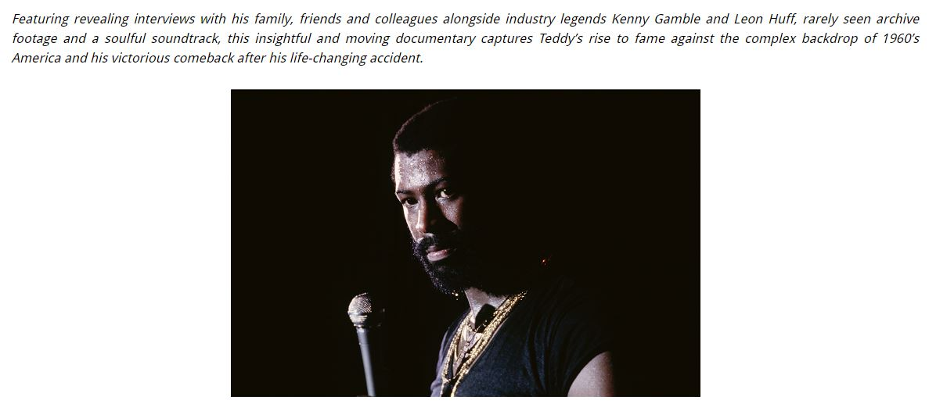
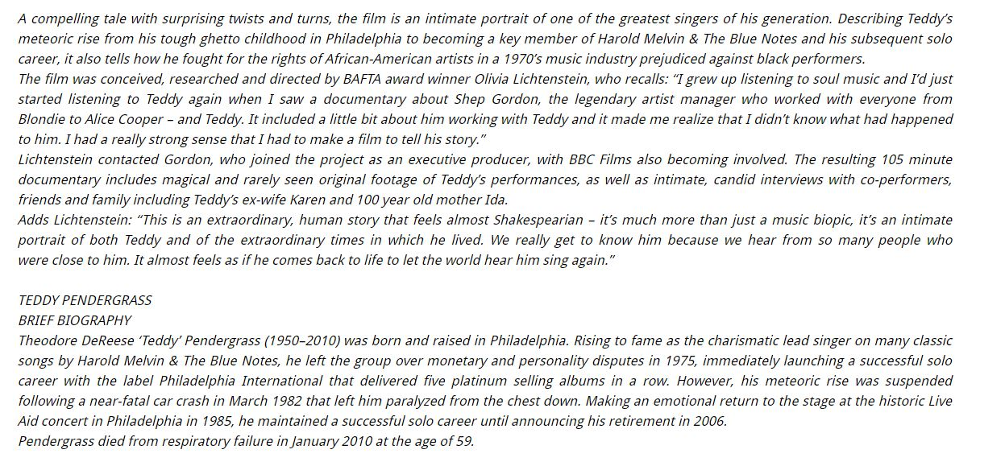
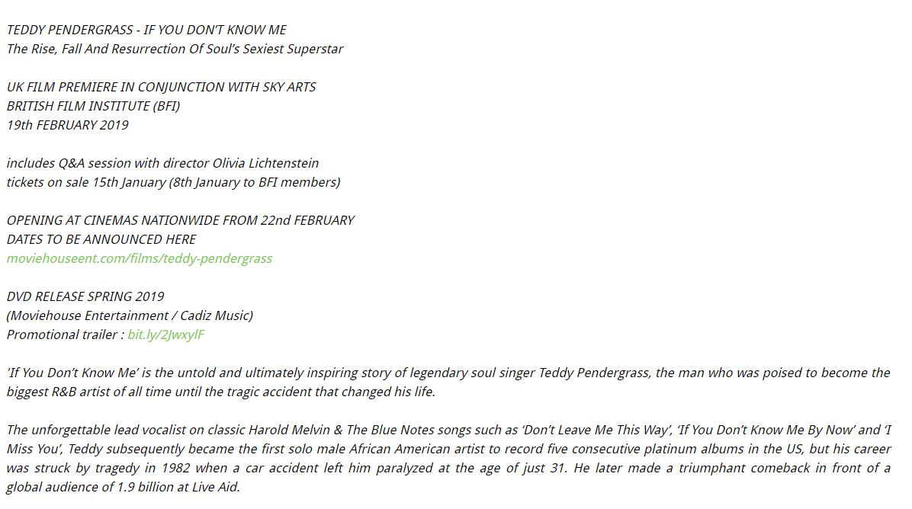
http://www.keysandchords.com/news-blog/teddy-pendergrass-if-you-dont-know-me-the-rise-fall-and-resurrection-of-souls-sexiest-superstar-uk-film-premiere-announced
Keys & Chords

