Slide 1
Welcome to Sir Ivan’s Castle The Summer Party – LIVE 2014
A High Octane Electro-Pop Concert
An Erotic Costume Dance and All-Night Pool Party
A Buzz-making Record Launch
A Major Annual Press Event
A Major Charity Fundraiser (with a $400 ticket)
And Without Question …
The Hamptons’ Wildest and Sexiest Summer Party

Slide 2
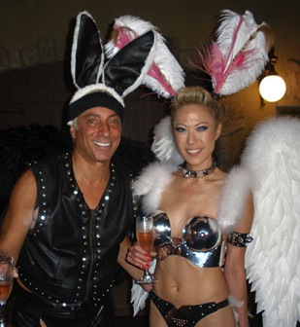
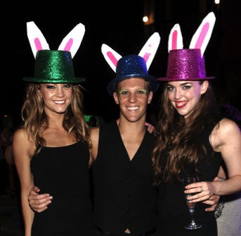
The Sexiest Page Six Event of the Year

Slide 3
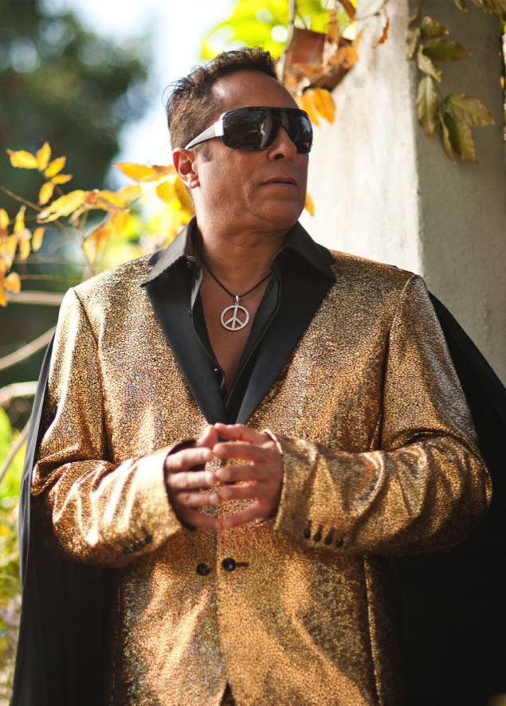
The Incredible Story of Sir Ivan
House Music Scene-Maker…
Billboard Chart Climber…
Extreme Philanthropist…
Erotica Enthusiast…
The One and Only Sir Ivan!
Once a successful banker, Sir Ivan is an international electro-pop star and media phenomenon. He soared from bank boardroom to Billboard's Top Ten.
Having already been seen on such TV networks as VH-1, Travel Channel, Syfy, and WE, Sir Ivan just shot an upcoming feature for E!
Social consciousness has provided the inspiration for his many worldwide Top Ten dance chart hit songs, and is also the driving passion of his life. The music, like his fabled summer party, funds his Peaceman Foundation which donates heavily to many great causes.
See a few of his hit music videos here:
Sir Ivan: Live For Today
https://www.youtube.com/watch?v=i2OZiDevsKE
Sir Ivan: Kumbaya
https://www.youtube.com/watch?v=RpdOiq-2DFU
Sir Ivan: La La Land
https://www.youtube.com/watch?v=cSKoNdV3_HY
Sir Ivan: Hare Krishna
www.youtube.com/watch?v=0disSFmrAZI

Slide 4
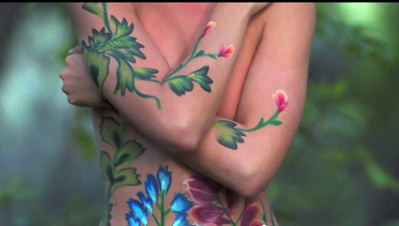
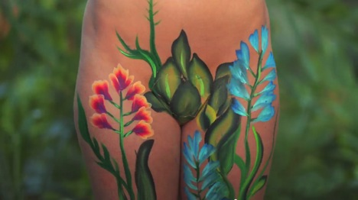
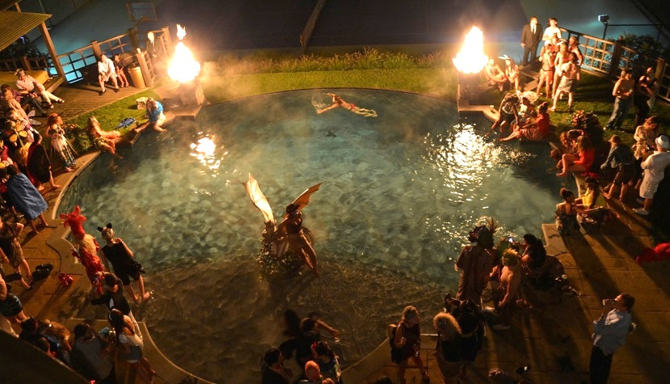
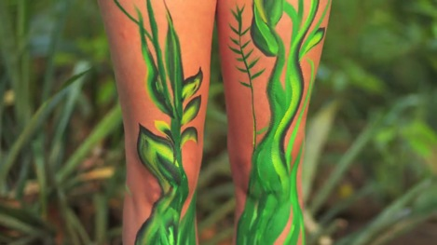
A Peek Inside the Event
Get Ready For …
Performances including brand new music from Sir Ivan
Sensual body painting and dance
Outrageous erotic costumes
Celebrity guests
Filmed highlights from previous events woven into the edited version
Insiders’ tour of the castle and its dungeon play rooms

Slide 5
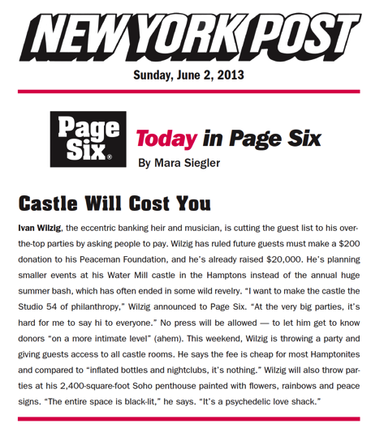
The Production
Produced/directed by 4-time Emmy Winner Jim Brown (Billy Joel for Showtime, Pete Seeger for HBO, etc.)
Live Shoot at the Actual Party -- Late August 2014
1080 HD
Edited 90 minute version – September 2014
© 2014 Pop Twist Entertainment, Inc. / Peaceman Productions LLC

